Slide 1



CHPC/UAMS – Computing 101
Malcolm Tobias
mtobias@wustl.edu
(314) 362-1594
chpc2.wustl.edu
chpc.wustl.edu
Notes:
<number>

Slide 2
CHPC/UAMS – Computing 101
Joseph Utecht
Jutecht@uams.edu
Notes:
<number>

Slide 3
Computing 101 Overview
Make it easier for beginners to start using the UAMS cluster
Address common hurdles new users face
But not just relevant for UAMS users, can apply skills learned in workshops to other computing situations as well
Notes:
<number>

Slide 4
What is High Performance Computing?
Is it Big Data? Not really…
Is it “the cloud”? No
HPC: Leveraging computing power beyond everyday capacity to do science and engineering
Notes:
<number>

Slide 5
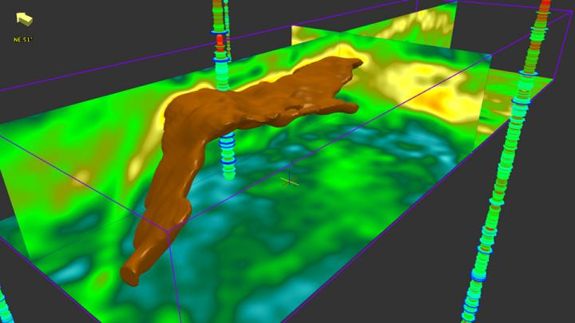
How HPC impacts us
Industry
Engineering
Oil & Gas
National Defense
Modeling of nuclear weapons
Cryptography/Cryptanalysis
Notes:
<number>

Slide 6
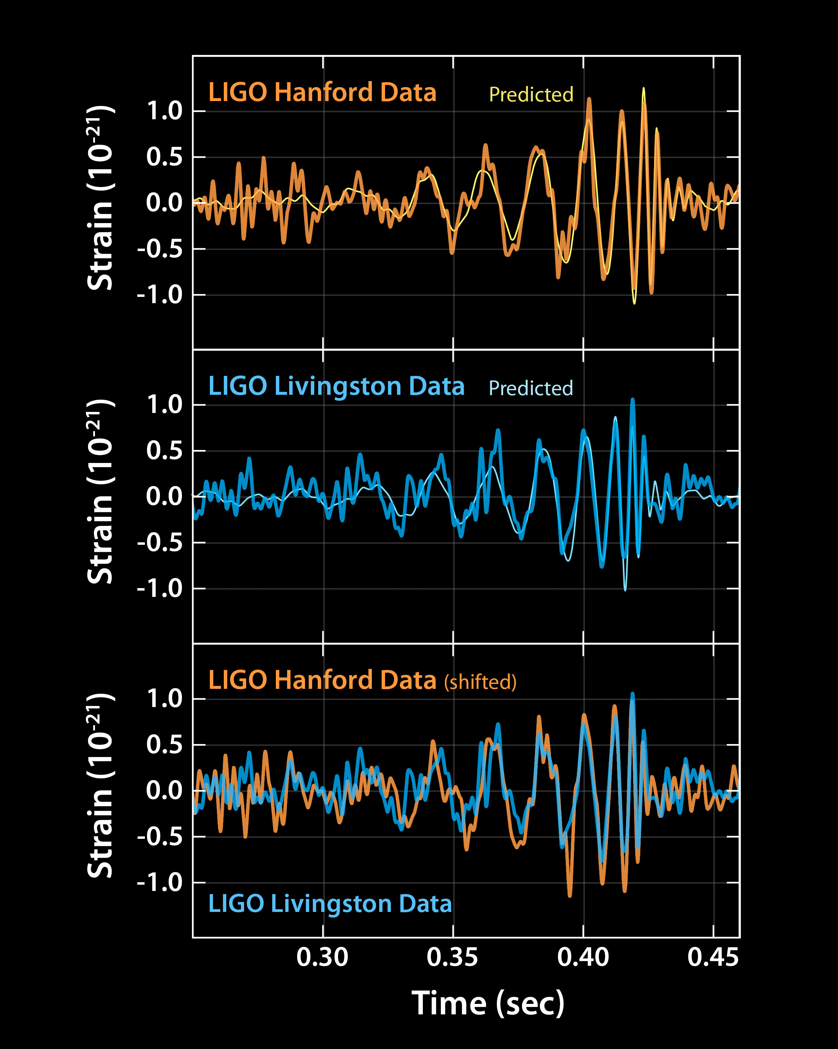
How HPC impacts us
Science
Physics:
particle physics, LIGO
Chemistry/Biology:
molecular modeling
drug discovery
Environmental Science:
weather forecasting
climate modeling
Genomics?
Notes:
<number>

Slide 7
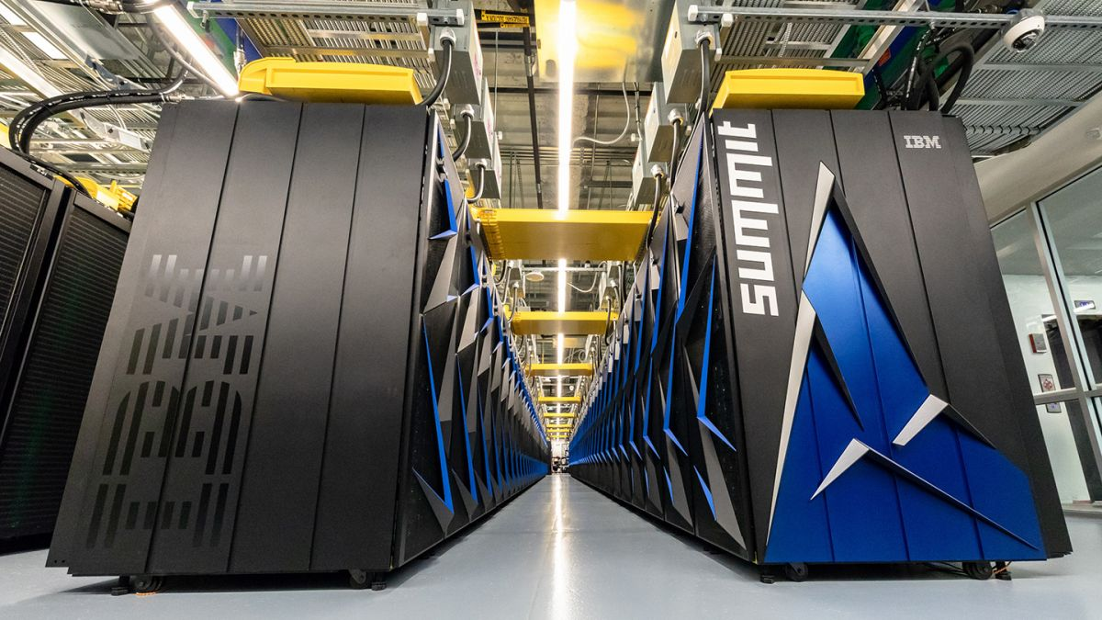
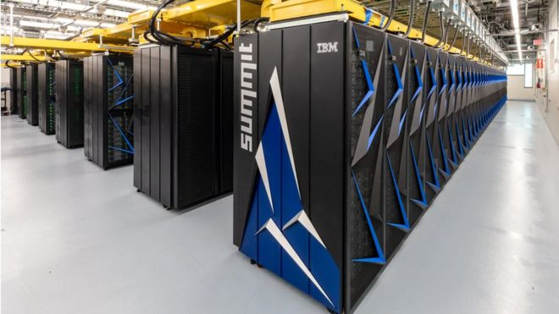
Summit Supercomputer
New #1
4608
$200M
4,608 Compute Nodes
27,648 GPUs
10PB of RAM
200 petaflop/s
Notes:
<number>

Slide 8
Supercomputer (Coming Soon)
“Aurora” - Argonne National Lab (2021)
$500M
Intel + Cray
1 exaflop/s (10^18: 1,000,000,000,000,000,000)
Notes:
<number>

Slide 9
Supercomputer (Coming Soon)
“Frontier” - Oak Ridge National Lab (?)
$600M
AMD + Cray
1.5 exaflop/s (10^18: 1,000,000,000,000,000,000)
Notes:
<number>

Slide 10
When to use a cluster – practical examples
When analyzing your data takes a really long time on your laptop or lab computer
When your files or datasets are really large
When you need to analyze a large number of files or datasets
When you don’t want to support a large number of scientific applications
Notes:
<number>

Slide 11
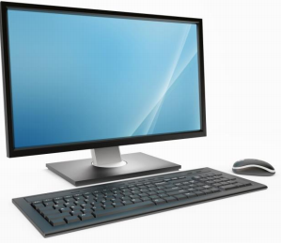

What does a cluster look like?
login node: login.hpc.uams.edu
high-speed network
Notes:
<number>

Slide 12
What is a typical workflow on the cluster?
Transfer your data onto the cluster from your local computer
Generate a “batch script” which will tell the system how to process your data
Transfer your results onto your local computer from the cluster
Notes:
<number>

Slide 13
CHPC/UAMS – Computing 101
#1 Tools to Connect and Move Data & Getting Around the Command Line Interface
#2 Text Editors and Shell Scripts
#3 Running Jobs on the UAMS Cluster
Notes:
<number>

Slide 14
CHPC/UAMS – Computing 101
#1 Tools to Connect and Move Data & Getting Around the Command Line Interface
Goals: to develop a basic understanding of the tools needed to connect to the UAMS HPC and transfer data back and forth, and to become familiar with the Unix file system and Unix commands
Notes:
<number>

Slide 15
What is a shell and why should I care?
A shell is a user interface for interacting with the operating system (OS) – either the OS on your laptop or the OS on a remote machine (like the UAMS cluster)
Two types of user interfaces:
GUI – Graphical User Interface (point and click)
CLI – Command Line Interface (text commands)
Notes:
<number>

Slide 16
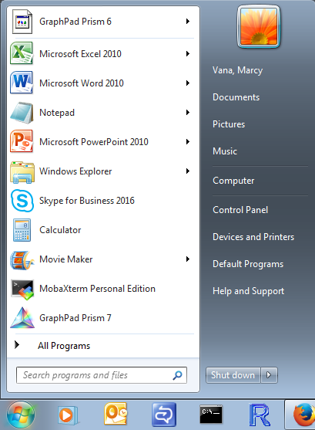
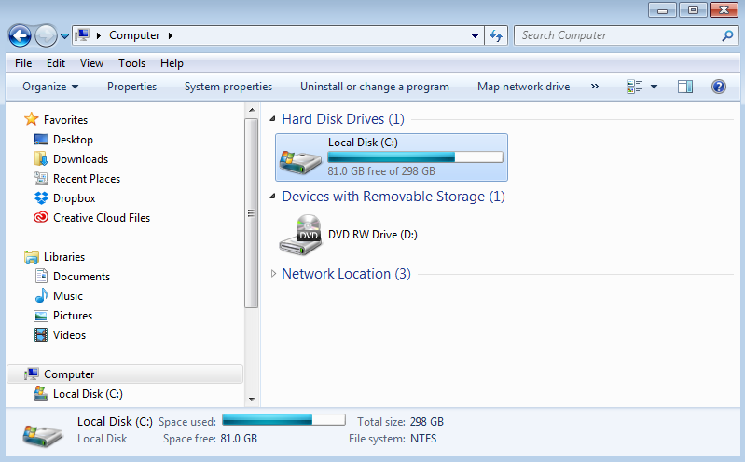
What is a shell and why should I care?
GUI – Graphical User Interface (point and click)
Notes:
<number>

Slide 17
What is a shell and why should I care?
GUI – Graphical User Interface (point and click)
Familiar – you have a GUI shell on your Mac or Windows computer (and your phone, tablet, etc.)
Intuitive
Little prior knowledge needed
Notes:
<number>

Slide 18
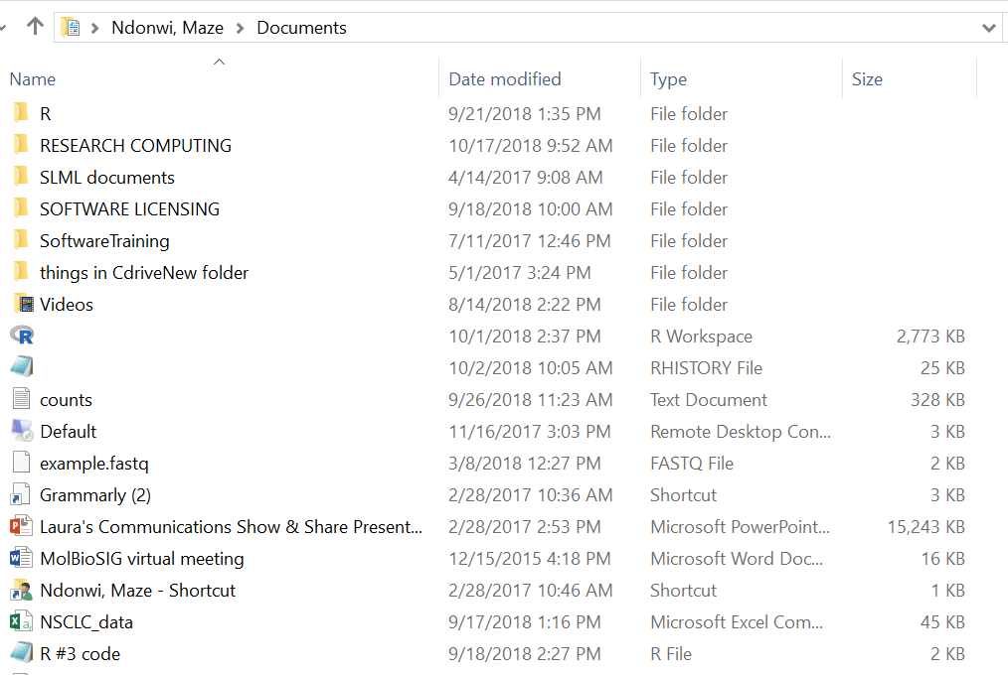
What is a shell and why should I care?
GUI – Graphical User Interface (point and click)
Point and click to explore folders/files and run programs
Notes:
<number>

Slide 19
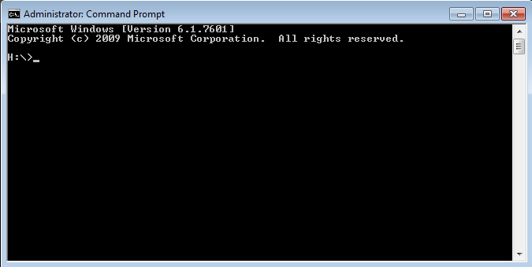
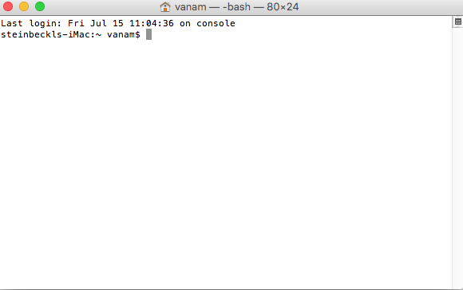
What is a shell and why should I care?
CLI – Command Line Interface (text commands)
Notes:
<number>

Slide 20
What is a shell and why should I care?
CLI – Command Line Interface (text commands)
You will have a CLI shell when you connect to the UAMS cluster
Notes:
<number>

Slide 21
What is a shell and why should I care?
CLI – Command Line Interface (text commands)
Simple commands with powerful options
Commands can be combined to automate tasks (shell scripts)
Steep learning curve as many commands must be learned
Notes:
<number>

Slide 22
What is a shell and why should I care?
CLI – Command Line Interface (text commands)
Type text commands at the prompt - $
Notes:
<number>

Slide 23
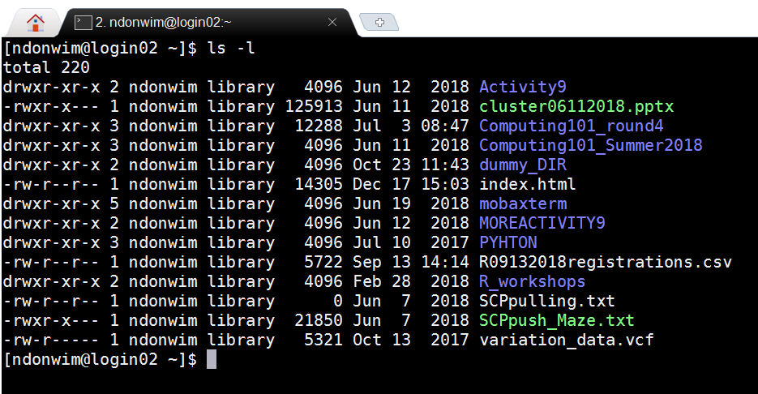
What is a shell and why should I care?
CLI – Command Line Interface (text commands)
Use text commands to explore folders/files and run programs
Notes:
<number>

Slide 24
How do I get a shell on (or connect to) a remote system (like the UAMS cluster)?
Using Secure SHell (SSH) “protocol”
Notes:
<number>

Slide 25
What is SSH?
Designed as a secure replacement for telnet
There are different software “implementations” of the SSH “protocol”
Requires either a username/password combination to authenticate or an “SSH key-pair”
Notes:
<number>

Slide 26
Where can I get SSH?
If you have a Linux machine or a Mac, the command line version of SSH is built-in
If you have a Windows machine, you can use MobaXterm (http://mobaxterm.mobatek.net/)
Notes:
<number>

Slide 27
Basic SSH command
ssh USERNAME@MACHINE
ssh guest@login.hpc.uams.edu
Notes:
<number>

Slide 28
Now what?
Now that you know how to get a CLI shell on the UAMS cluster, how do you use it to interact with the Unix operating system on the cluster?
It’s time for some Unix basics…
Notes:
<number>

Slide 29
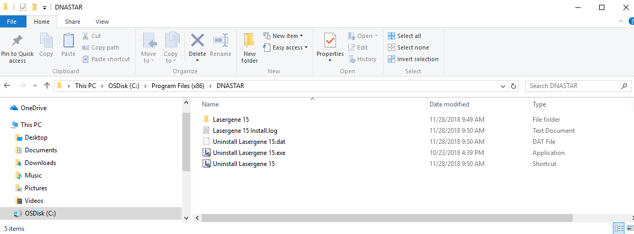
The Unix file-tree structure
Similar to the organization of folders, sub-folders and files on a Windows machine or a Mac
Notes:
<number>

Slide 30
The Unix file-tree structure
At the top of the Unix file-tree is the root directory:
(directories ≡ folders)
/
/home
/usr
/scratch
/tmp
/home/guest
/home/ndonwim
/usr/bin
/scratch/guest
/scratch/ndonwim
Notes:
<number>

Slide 31
The Unix file-tree structure
Below/within the root directory are the home and scratch directories for each user:
/
/home/USERNAME
/scratch/USERNAME
/home
/usr
/scratch
/tmp
/home/guest
/home/ndonwim
/usr/bin
/scratch/guest
/scratch/ndonwim
Notes:
<number>

Slide 32
The Unix file-tree structure
You can’t double-click to move around directories and open files in the command line interface as you would on your Mac or Windows machine
Directory locations and files need to be expressed as paths
Notes:
<number>

Slide 33
The Unix file-tree structure
Imagine there is a file named my_file in the guest home directory
/
/home
/usr
/scratch
/tmp
/home/guest
/home/ndonwim
/usr/bin
/scratch/guest
/scratch/ndonwim
Notes:
<number>

Slide 34
The Unix file-tree structure
Express the location of my_file using a path
Absolute path – starting from the root directory
/home/guest/my_file
/
/home
/usr
/scratch
/tmp
/home/guest
/home/ndonwim
/usr/bin
/scratch/guest
/scratch/ndonwim
Notes:
<number>

Slide 35
The Unix file-tree structure
Making use of aliases (or shortcuts):
~ user’s home directory (or guest home directory)
Absolute path – starting from the root directory
/home/guest/my_file
~/my_file
Notes:
<number>

Slide 36
The Unix philosophy on commands
Write commands that do one thing and do it well
Write commands to work together
Write commands to handle text streams, because that is a universal interface
Notes:
<number>

Slide 37
Unix commands
Typically short – many basic commands are two characters long
Commands often require arguments and have options
command –o --option argument1 argument2
Notes:
<number>

Slide 38
Unix commands
Commands usually provide basic documentation
command
command --help
Notes:
<number>

Slide 39
Unix commands
man(ual) pages:
The most accurate description of a command is the ‘man’ page
man command
Notes:
<number>

Slide 40
Unix commands
man(ual) pages:
Use space bar to page through ‘man’ page and ‘q’ to quit
Not easy to read but provides the most complete and accurate information about the command
Notes:
<number>

Slide 41
Basic Unix commands
ls = List what’s in the directory, either the directory you’re in or another directory
[guest@login01 ~]$ ls
sleep.batch variation_data.vcf weather_data_newyork.csv
Notes:
<number>

Slide 42
Basic Unix commands
ls = List what’s in the directory, either the directory you’re in or another directory
[guest@login01 ~]$ ls /
act boot dev export HCP lib lost+found misc net opt root scratch srv tmp var bin cgroup etc grub.txt home lib64 media mnt NRG proc sbin selinux sys usr
Notes:
<number>

Slide 43
Basic Unix commands
cd = Change Directory, move to a different directory
[guest@login01 ~]$ cd /
[guest@login01 /]$
Notes:
<number>

Slide 44
Basic Unix commands
pwd = Print Working Directory, returns your current location in the file-tree structure (also called your working directory)
[guest@login01 ~]$ pwd
/home/guest
Notes:
<number>

Slide 45
Manipulating Files & Directories
mkdir = Make Directory
mv = Move a file or directory from A to B
[guest@login01 ~]$ mkdir ~/tmp/Data
[guest@login01 ~]$ mv ~/tmp/study_data.csv ~/tmp/Data
[guest@login01 ~]$ ls ~/tmp/Data
study_data.csv
Notes:
<number>

Slide 46
Manipulating Files & Directories
rm = Remove file or directory
rmdir = Remove Directory (directory must be empty)
[guest@login01 ~]$ rm ~/tmp/Data/study_data.csv
[guest@login01 ~]$ rmdir ~/tmp/Data
[guest@login01 ~]$ ls ~/tmp/Data
ls: cannot access /home/guest/tmp/Data: No such file or directory
Notes:
<number>

Slide 47
Unix’s Most Dangerous Command!!!
rm -rf = recursively (r) go through directory and delete any files encountered. Force (f) the removal (don’t bother prompting me)
[guest@login01 ~]$ mkdir ~/tmp/Images
[guest@login01 ~]$ mv ~/control.dicom ~/tmp/Images
[guest@login01 ~]$ ls ~/tmp/Images
control.dicom
Notes:
<number>

Slide 48
Unix’s Most Dangerous Command!!!
rm -rf = recursively (r) go through directory and delete any files encountered. Force (f) the removal (don’t bother prompting me)
[guest@login01 ~]$ rmdir ~/tmp/Images
rmdir: failed to remove ‘/home/guest/tmp/Images’:Directory not empty
[guest@login01 ~]$ rm –rf ~/tmp/Images
[guest@login01 ~]$ ls ~/tmp/Images
ls: cannot access /home/guest/tmp/Images: No such file or directory
Notes:
<number>

Slide 49
Running Multiple Commands Simultaneously
When a command is executed, the shell doesn’t return to the prompt until the command has finished:
[guest@login01 ~]$ sleep 30
But we often want to run other commands before the first command has finished (like a text editor)
Notes:
<number>

Slide 50
Running Multiple Commands Simultaneously
If we’ve already started the command, we can stop it (Ctrl-z) and background it (bg):
[guest@login01 ~]$ sleep 120
^Z
[1]+ Stopped sleep 120
[guest@login01 ~]$ bg
[1]+ sleep 120&
Notes:
<number>

Slide 51
Running Multiple Commands Simultaneously
Alternatively, we can just start the process in the background by adding an ampersand (&) to the end of the command:
[guest@login01 ~]$ emacs&
[3]16327
[guest@login01 ~]$
Notes:
<number>

Slide 52
Moving files to/from remote systems (like the UAMS cluster)
SCP – Secure CP, designed as a secure replacement for cp (copy)
SFTP - Secure FTP, designed as a secure replacement for FTP (File Transfer Protocol)
Notes:
<number>

Slide 53
What are SCP and SFTP?
SCP and SFTP are also “protocols”, so there are different software “implementations” of these as well
SCP and SFTP use the same authentication mechanism as SSH
Notes:
<number>

Slide 54
Where can I get SCP and SFTP?
If you have a Linux machine or a Mac, the command line versions of SCP and SFTP are built-in
If you have Windows, you can use MobaXterm (http://mobaxterm.mobatek.net/)
Notes:
<number>

Slide 55
Basic SCP command – #1
**copy a file from your laptop to the cluster**
scp MY_FILE USERNAME@MACHINE:PATH_TO_FILE
scp ~/desktop/SCPtoCHPC.txt guest@login.hpc.uams.edu:~
Notes:
<number>

Slide 56
Basic SCP command – #2
**copy a file from the cluster to your laptop**
scp USERNAME@MACHINE:PATH_TO_FILE LOCAL_FILE
scp guest@login.hpc.uams.edu:~/SCPtoLaptop.txt ~/desktop
Notes:
<number>

Slide 57
Warning: file names with spaces
In the Windows and Mac world, it’s common to use spaces in file names like:
this is my file.txt
In the Unix/Linux world, spaces are used to separate arguments in commands:
command argument1 argument2 argument3
It’s best to avoid spaces in file names in the Unix/Linux world
Notes:
<number>

Slide 58
Warning: file names with spaces
It’s best to avoid spaces in file names in the Unix/Linux world – but you can deal with them if you have to…
To tell Unix/Linux, to ‘protect’ (or recognize) the spaces, use the “\” character:
this is my file.txt
this\ is\ my\ file.txt
Notes:
<number>

