Slide 1



CHPC/UAMS – Computing 101
Malcolm Tobias
mtobias@wustl.edu
(314) 362-1594
chpc2.wustl.edu
chpc.wustl.edu
Notes:
<number>

Slide 2
CHPC/UAMS – Computing 101
Joseph Utecht
Jutecht@uams.edu
Notes:
<number>

Slide 3
CHPC/UAMS – Computing 101
#1 Tools to Connect and Move Data & Getting Around the Linux Command Line Interface
#2 Text Editors and Shell Scripts
#3 Running Jobs on the UAMS Cluster
Notes:
<number>

Slide 4
CHPC/UAMS – Computing 101
#2 Text Editors and Shell Scripts
Goal: to gain knowledge of some of the options for text editors and learn how to write and execute basic shell scripts
Notes:
<number>

Slide 5
What is a typical workflow on the cluster?
Transfer your data onto the cluster from your local computer
Generate a “batch script” which will tell the system how to process your data
Transfer your results onto your local computer from the cluster
Notes:
<number>

Slide 6
Batch scripts and shell scripts
Batch scripts tell the system how to process your data
Before we get to batch scripts, we need to introduce shell scripts
Batch scripts are shell scripts with additional functionality (more on batch scripts next week)
Notes:
<number>

Slide 7
Shell Scripts
A text file with a series of Unix commands
Useful for automating a series of commands
Each shell has its own syntax, but all support programming structures like loops, conditionals, etc.
Powerful enough that it becomes possible to create what are essentially new commands
Notes:
<number>

Slide 8
Text Editors
Used to write and edit shell and batch scripts
Many types of text editors – some with a command line interface (CLI) and some with a graphical user interface (GUI)
Text editors with a CLI are tricky to learn, so this is a great time for text editor with a GUI!
Notes:
<number>

Slide 9
Text Editors - Windows Warning!
If you edit your script on a Windows system and transfer it to the cluster, you will have problems due to formatting errors!
Windows terminates each line with both a line feed and carriage return, while UNIX just uses a line feed.
Notes:
<number>

Slide 10
X11: The UNIX GUI Framework
X11 not only allows you to run GUIs directly on a UNIX system, you can also run GUIs on remote systems and have them display on your local system
In our case, the text editor application is running on the UAMS cluster, but the text editor window will open on our laptops
Notes:
<number>

Slide 11
X11: The UNIX GUI Framework
If you have Linux, X11 is already there
If you have a Mac, X11 is included in OS X 10.5 through 10.7, otherwise you’ll need to install
XQuartz: https://www.xquartz.org/
If you have Windows, you can use MobaXterm
(http://mobaxterm.mobatek.net/)
Notes:
<number>

Slide 12
X11: The UNIX GUI Framework
SSH can “tunnel” X11 so that it travels through a secure connection.
Just add the '-Y' flag if using the built-in Linux/Mac command line SSH tools:
ssh -Y USERNAME@MACHINE
i.e. ssh -Y guest@login.hpc.uams.edu
Notes:
<number>

Slide 13
X11: The UNIX GUI Framework
MobaXterm (for Windows users) has an SSH client that will automatically tunnel X11 so we don’t need the –Y flag
ssh USERNAME@MACHINE
ssh guest@login.hpc.uams.edu
Notes:
<number>

Slide 14
Text Editors
Many options – gedit, Emacs, gVim, etc.
gedit – good editor for anyone just getting started
Notes:
<number>

Slide 15
Text Editors – gedit
About as basic as it gets
Looks like Notepad
Many basic features
Notes:
<number>

Slide 16
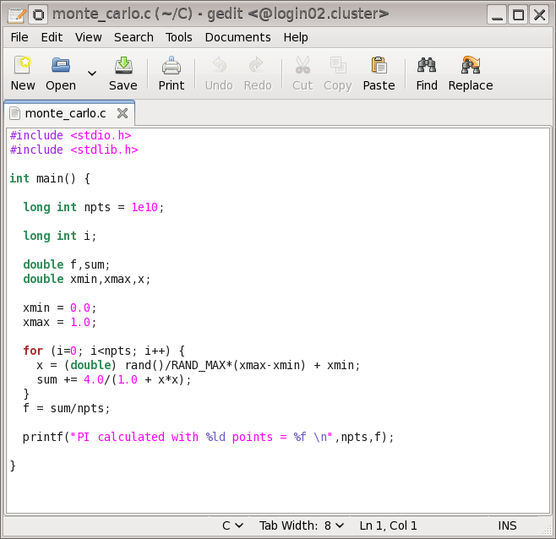
Text Editors – gedit
Notes:
<number>

Slide 17
Shell Scripts – Workflow
1 Write the script in a text editor
2 Make the script executable
3 Run the script
Notes:
<number>

Slide 18
Shell Scripts – How Do I Write Them?
Lines beginning with ‘#’ are usually interpreted as comments
Important exception is the first line of a shell script:
#!/bin/sh
“#!” denotes the “magic number”, which defines what interpreter to run the shell script under
Notes:
<number>

Slide 19
Shell Scripts – Magic Numbers
Tcsh shell script:
#!/bin/tcsh
BASH script:
#!/bin/bash
Python:
#!/usr/bin/python
Perl:
#!/usr/bin/perl -w
Notes:
<number>

Slide 20
Shell Scripts – How Do I Write Them?
To execute a Unix command from a shell script, just enter the command on a new line in your script
Notes:
<number>

Slide 21
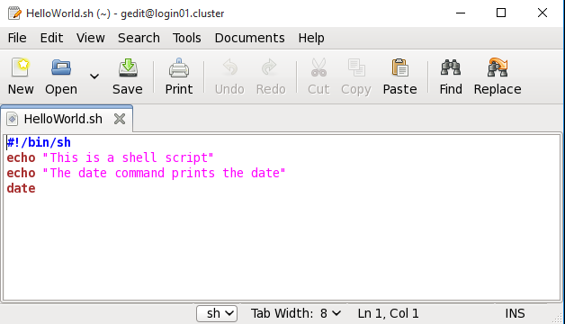
Shell Scripts – How Do I Write Them?
The echo command is used to print text to the screen (very useful for debugging)
Notes:
<number>

Slide 22
Shell Scripts – How Do I Write Them?
Use cat to read the contents of your shell script
[mtobias@login01 ~]$ cat HelloWorld.sh
#!/bin/sh
echo “This is a shell script”
echo “The date command prints the date”
date
Notes:
<number>

Slide 23
Shell Scripts – Making Scripts Executable
When creating a new shell script, it will inherit the default permissions for a file:
[mtobias@login01 ~]$ ls –l HelloWorld.sh
-rw-r--r-- 1 mtobias admin 88 Sep 21 09:13 HelloWorld.sh
Notes:
<number>

Slide 24
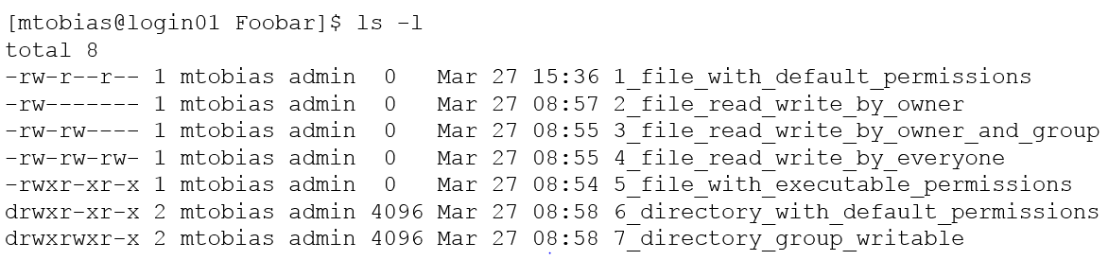
File & Directory Permissions
-l option on ls returns the long list of contents
- = file
d = directory
Notes:
<number>

Slide 25
File & Directory Permissions
permissions of Owner (you)
permissions = r (Read) / w (Write) / x (eXecute)
Notes:
<number>

Slide 26
File & Directory Permissions
permissions of Group (your lab/research group)
permissions = r (Read) / w (Write) / x (eXecute)
Notes:
<number>

Slide 27
File & Directory Permissions
permissions of Everyone (everyone that uses the cluster)
permissions = r (Read) / w (Write) / x (eXecute)
Notes:
<number>

Slide 28
File & Directory Permissions
touch = If file doesn’t exist, create it. If it does exist, change its modification time (introduced in Computing 101 – session 1)
[mtobias@login01 ~]$ ls –l ~/tmp/test
-rw-r--r-- 1 mtobias admin 0 Jul 22 10:12 /home/mtobias/tmp/test
[mtobias@login01 ~]$ touch ~/tmp/test
[mtobias@login01 ~]$ ls –l ~/tmp/test
-rw-r--r-- 1 mtobias admin 0 Jul 25 11:44 /home/mtobias/tmp/test
Notes:
<number>

Slide 29
File & Directory Permissions
chmod = Change Mode of file or directory (change file or directory permissions)
Unix numbering scheme for file permissions
read = 4
write = 2
execute = 1
Notes:
<number>

Slide 30
File & Directory Permissions
read = 4
write = 2
execute = 1
chmod = Change Mode of file or directory (change file or directory permissions)
[mtobias@login01 ~]$ chmod 600 ~/tmp/test
[mtobias@login01 ~]$ ls –l ~/tmp/test
-rw------- 1 mtobias admin 0 Jul 25 11:44 /home/mtobias/tmp/test
[mtobias@login01 ~]$ chmod 660 ~/tmp/test
[mtobias@login01 ~]$ ls –l ~/tmp/test
-rw-rw---- 1 mtobias admin 0 Jul 25 11:44 /home/mtobias/tmp/test
[mtobias@login01 ~]$ chmod 664 ~/tmp/test
[mtobias@login01 ~]$ ls –l ~/tmp/test
-rw-rw-r-- 1 mtobias admin 0 Jul 25 11:44 /home/mtobias/tmp/test
only owner can read/write
owner + group can read/write
everyone can read, owner + group can also write
Notes:
<number>

Slide 31
Shell Scripts – Making Scripts Executable
Before we can run a shell script we need to make it executable:
[mtobias@login01 tmp]$ chmod +x HelloWorld.sh
[mtobias@login01 tmp]$ ls –l HelloWorld.sh
-rwxr-xr-x 1 mtobias admin 88 Sep 21 09:13 HelloWorld.sh
Notes:
<number>

Slide 32
Shell Scripts – Running Shell Scripts
To run a shell script just enter the path to the script at the prompt
Reminder…
Absolute path – starting from the root directory:
/home/mtobias/tmp/HelloWorld.sh
Absolute path – making use of the home alias (~)
~/tmp/HelloWorld.sh
Notes:
<number>

Slide 33
Shell Scripts – Running Shell Scripts
To run a shell script just enter the path to the script at the prompt
Relative path – making use of another alias (.)
./HelloWorld.sh
“.” represents your current directory
Notes:
<number>

Slide 34
Shell Scripts – Running Shell Scripts
To run a shell script just enter the path to the script at the prompt
[mtobias@login01 tmp]$ ./HelloWorld.sh
This is a shell script
The date command prints the date
Wed Sep 21 09:19:44 CDT 2016
Notes:
<number>

Slide 35
Shell Scripts – Additional Concepts
Variables
Conditionals
Loops
Notes:
<number>

Slide 36


Shell Scripts – Variables
Traditionally variables are defined using all capital letters
Putting a dollar sign in front of a variable means “give me the value of the variable”
Notes:
<number>

Slide 37
Bourne Shell Scripts – Conditionals
If this, then that…
[mtobias@login01 ~]$ cat /home/mtobias/tmp/conditionals.sh
#!/bin/bash
T1=“FILE1”
T2=“FILE2”
if [ “$T1” = “$T2” ];
then
echo expression evaluated as true
else
echo expression evaluated as false
fi
Notes:
<number>

Slide 38
Bourne Shell Scripts – Conditionals
If this, then that…
[mtobias@login01 ~]$ cat /home/mtobias/tmp/torqueGPU.sh
#!/bin/bash
if [[ -e $PBS_GPUFILE ]]
then
# For each host, build the CUDA_VISIBLE_DEVICES list so the job only sees GPUs that have # been assigned to the job
HOST=`hostname`
HOSTGPUS=`grep $HOST $PBS_GPUFILE | perl –p –e ‘s/\n+/,/’ | perl –p –e ‘s/,$//’`
HOSTGPUS=${HOSTGPUS//$HOST/}
HOSTGPUS=${HOSTGPUS//-gpu/}
export CUDA_VISIBLE_DEVICES=$HOSTGPUS
echo “HOST=“ $HOST “CUDA_VISIBLE_DEVICES=“ $CUDA_VISIBLE_DEVICES
else
export CUDA_VISIBLE_DEVICES=“”
fi
Notes:
<number>

Slide 39
Bourne Shell Scripts – Loops
Loops – execute a command over and over again a specified number of times
Use a for loop with a set of defined values
Use a while loop to run until a specified condition is no longer met
Notes:
<number>

Slide 40
Bourne Shell Scripts – Loops
Loops – an example of a while loop
[mtobias@login01 tmp]$ cat ~/tmp/countTo10.sh
#!/bin/sh
COUNTER=0
while [ $COUNTER –lt 10 ]
do
echo $COUNTER
COUNTER=`expr $COUNTER + 1`
done
* lt means less than in the example above
Notes:
<number>

